Slide 1

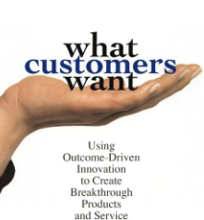
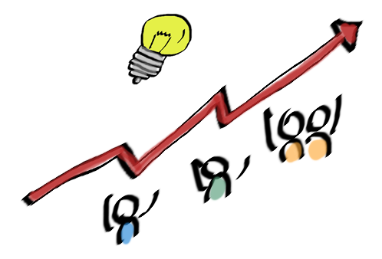
MSC3182
SOCIAL ENTREPRENEURSHIP
Lesson 3
OUTCOME DRIVEN INNOVATION
https://aktiasolutions.com/outcome-driven-innovation/

Slide 2



LAUNCH A BLOCK BUSTER PRODUCT
NO
HELP YOU LAUNCH A PRODUCT
MAY NOT BE A BLOCK BUSTER PRODUCT
An unusually successful product or service with huge sales.

Slide 3

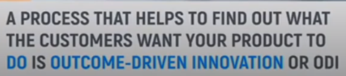
LAUNCH A BLOCK BUSTER PRODUCT

Slide 4
OUTCOME-DRIVEN INNOVATION
Outcome-Driven Innovation (ODI) is a strategy and innovation process developed by Anthony W. Ulwick.
It is built around the theory that people buy products and services to get jobs done.
As people complete these jobs, they have certain measurable outcomes that they are attempting to achieve
It links a company's value creation activities to customer-defined metrics.
ODI attempts to identify important but poorly served, and unimportant but over-served, jobs and outcomes.

Slide 5
OUTCOME-DRIVEN INNOVATION
ODI focuses on customer-desired outcome
By knowing how customers measure value, companies are able to align the actions of marketing, development, and R&D with these metrics and systematically create customer value.

Slide 6
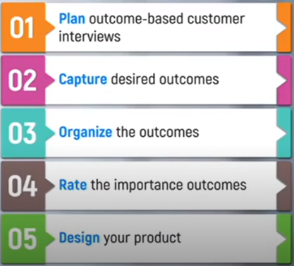
OUTCOME-DRIVEN INNOVATION – KEY STEPS

Slide 7
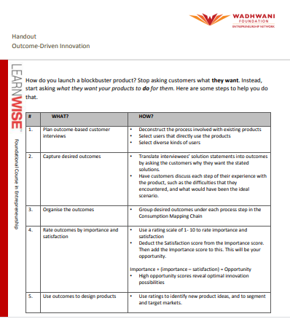
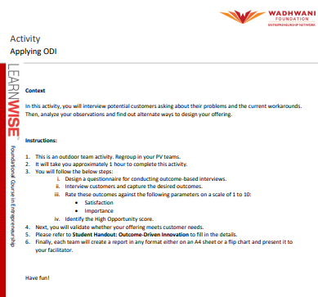
OUTCOME-DRIVEN INNOVATION – KEY STEPS

